Slide 1
AI2C TECHNICIAN Course Intro

Slide 2
Technician Course Structure
Summer prep (Jul – Aug)
CMU course (Aug – May)
AI2C specific training (May – Jun, TBD)

Slide 3
Summer Schedule

Slide 4
SUMMER Daily Schedule
1000 – UTC – Morning class
1300 – UTC – Afternoon class

Slide 5
CMU Schedule - Fall
Fall semester covers foundational technical skills:
1. Python Programming (Weeks 1-9)
2. Cloud Architecture (Weeks 1-7)
3. DevOps (Weeks 8-12)
4. Data Engineering (Weeks 10-12)

Slide 6
CMU Schedule - Spring
Spring semester covers foundational technical skills:
1. Cloud Native Development (Weeks 1, 3, 5, 7, 9, 11, 12)
2. AI Practitioner (Weeks 2, 4, 6, 8, 10)
3. Capstone Project (Throughout semester)

Slide 7
CMU WEEKLY Schedule
Monday:
• 9:30-11:30 AM: Two lectures
• 11:30 AM-12:20 PM: Review session with Teaching Assistants
Tuesday:
• No scheduled class activities, time for project work and self-study
Wednesday:
• 9:30 AM-12:00 PM: Recitations for Group A
• 1:00-3:30 PM: Recitations for Group B
Thursday:
• Weekly quiz opens (1 hour to complete, due by midnight) , time for project work and self-study
Friday:
• Next week content and primer modules open
Saturday:
• Weekly projects due; Previous week’s discussion responses due

Slide 8
Instructor Intros
MAJ Ryan Neville
Commissioned in 2012, Engineer
Engineer Diver (2013 – 2020)
Grad School (2020-2021)
USMA Assistant Professor (2021-2025)
AI2C Technician (2025 – now)
MAJ Ethan Shafer
Commissioned in 2013, Air Defense
PL / XO
VTIP 26B
Automations OIC
Grad School
USMA Assistant Professor
AI2C Technician, R&E

Slide 9
Class Intros
Name
Rank
What you do in the Army
Where you're coming from
Your experience level with AI/Tech/Coding

Slide 10
Expectations
College courses
Python experience
DevOps
Cloud
Garbage in, garbage out
Do the material
Optional exercises
Accelerated program, no spoon-feeding
Academic Freedom / Equality
What do you want out of this?

Slide 11
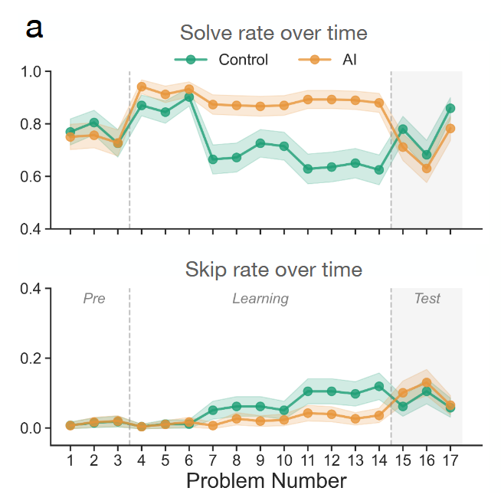
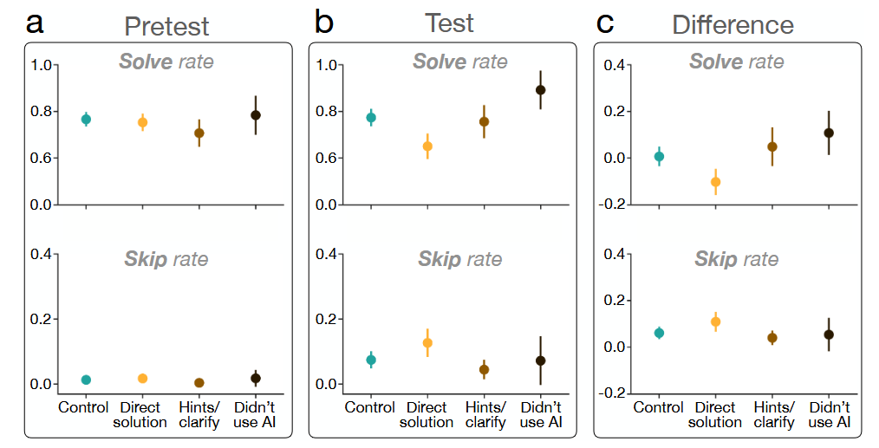
AI Assistance
It’s not “don’t use AI”
It’s “use AI intelligently”
Notes:
Fraction (math) problems
Over 500 participants
Significant differences in groups (ANOVA)
https://arxiv.org/pdf/2604.04721

Slide 12
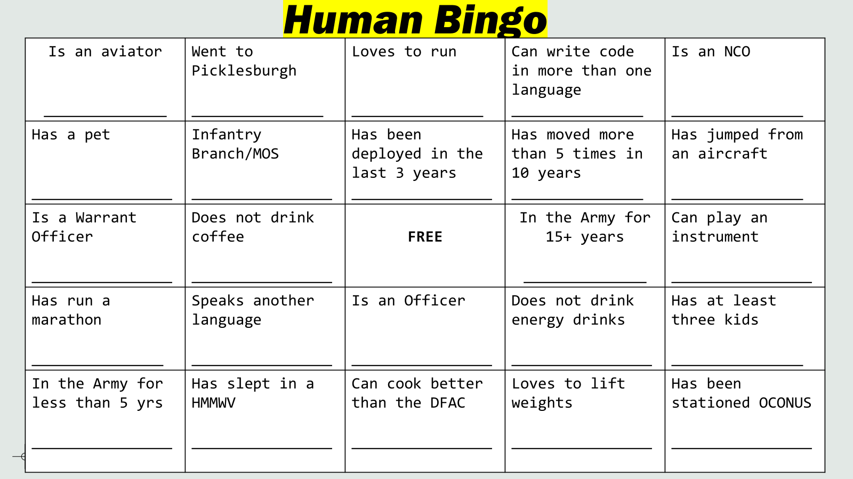
Icebreaker - Human Bingo

Slide 13
Questions

